Slide 1
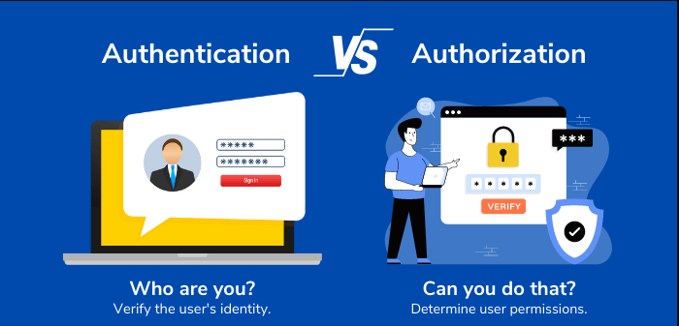
Authorization and Authentication
Section 1 : Group 9
Group Members Nitin Thakkar Prarthana Puranik Raj Panjwani
Big Data Analytics – BDAT1001

Slide 2
Project Summary
This Project shows how to create an ASP.NET Core web app with user data protected by authorization. It displays a list of contacts that authenticated (registered) users have created. There are three security groups:
Registered users can view all the approved data and can edit/delete their own data.
Managers can approve or reject contact data. Only approved contacts are visible to users.
Administrators can approve/reject and edit/delete any data.

Slide 3
Team Profile
Prarthana Puranik
Nitin Thakkar
Raj Panjwani
Software Developer | BI Developer | Data Engineer With 6 Years of Experience
Embedded software Developer with 9 Years of Experience
Software Developer Intern | Python Developer

Slide 4
Part 1 : User data protected by authorization

Slide 5
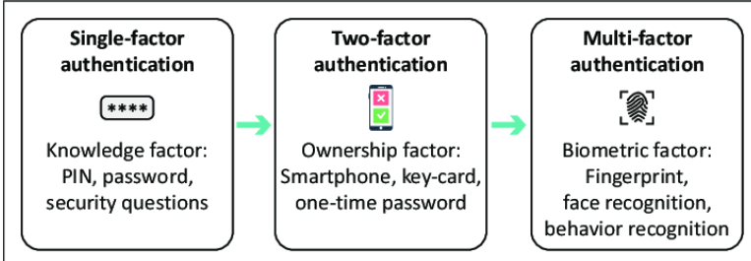
What is Authentication ?
Enables organizations to keep their networks secure by permitting only authenticated users .
Several authentication types
Single-factor authentication (SFA)
User ID and password
Two-factor authentication (2FA)
Additional authentication factors, such as a unique code (OTP)
biometric signature, like a facial scan or thumbprint
Multifactor authentication (MFA)
three or more identity verification factors are used for authentication
E.g. a user ID and password, biometric signature and perhaps a personal question the user must answer
Notes:
Authentication is the process of determining whether someone or something is, in fact, who or what it says it is. Authentication technology provides access control for systems by checking to see if a user's credentials match the credentials in a database of authorized users or in a data authentication server. In doing this, authentication assures secure systems, secure processes and enterprise information security.
There are several authentication types. For purposes of user identity, users are typically identified with a user ID, and authentication occurs when the user provides credentials such as a password that matches their user ID. The practice of requiring a user ID and password is known as single-factor authentication (SFA). In recent years, companies have strengthened authentication by asking for additional authentication factors, such as a unique code that is provided to a user over a mobile device when a sign-on is attempted or a biometric signature, like a facial scan or thumbprint. This is known as two-factor authentication (2FA).

Slide 6

What is Authorization ?
Authorization is the process of giving someone the ability to access a resource.
Authorization rules are part of an IT discipline called Identity and Access Management (IAM)
A good example is house ownership. The owner has full access rights to the property (the resource) but can grant other people the right to access it. You say that the owner authorizes people to access it.
Types Of Authorization
API keys
Basic Auth
HMAC (Hash-based Message Authentication Code)
OAuth
Notes:
In computer systems, authorization rules are part of an IT discipline called Identity and Access Management (IAM). Within IAM, authorization and authentication help system managers to control who has access to system resources and set client privileges. The way that IT systems deal with authorization services is very similar to a real-world access control process.
API keys
In order to utilize most APIs, you must first sign up for an API key. The API key is a long string that is typically included in the request URL or header.
Basic Auth
Basic Auth is another type of authorization. The sender inserts a username: password into the request header using this way. Base64 is an encoding technique that turns the login and password into a set of 64 characters to ensure secure transmission.
HMAC
HMAC stands for Hash-based Message Authentication Code. It is a digital signature algorithm designed to reuse the message digest Algorithm like MD5 and SHA-1 and provide an efficient data integrity protocol mechanism.
OAuth
Another type of authorization is OAuth, open access delegation standard that allows Internet users to grant websites or applications access to their information on other websites without having to give them their passwords. Companies like Amazon, Google, Facebook, Microsoft, and Twitter employ this technology to let users to exchange information about their accounts with third-party applications or websites. On behalf of a resource owner, OAuth grants clients “secure delegated access” to server resources.

Slide 7
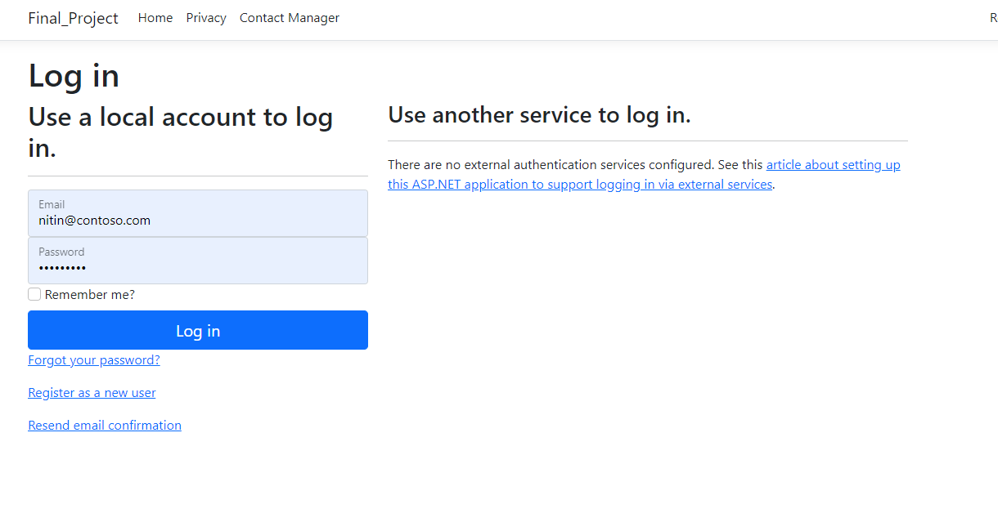
Administrative Login

Slide 8
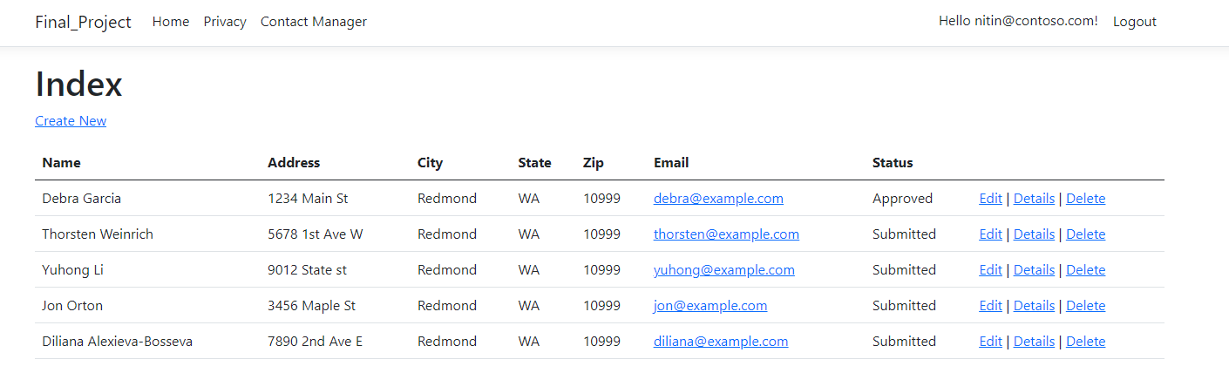
Administrative Login

Slide 9
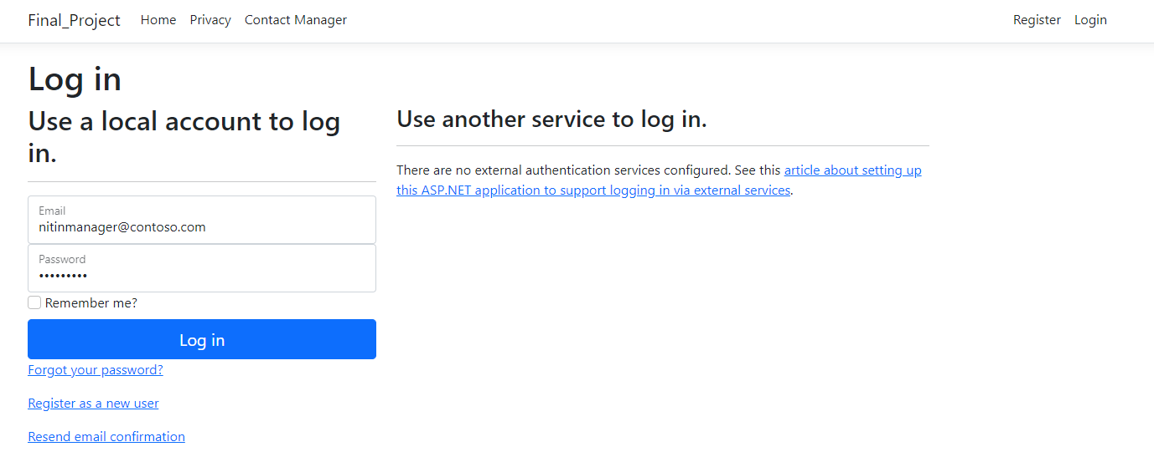
Manager Login

Slide 10
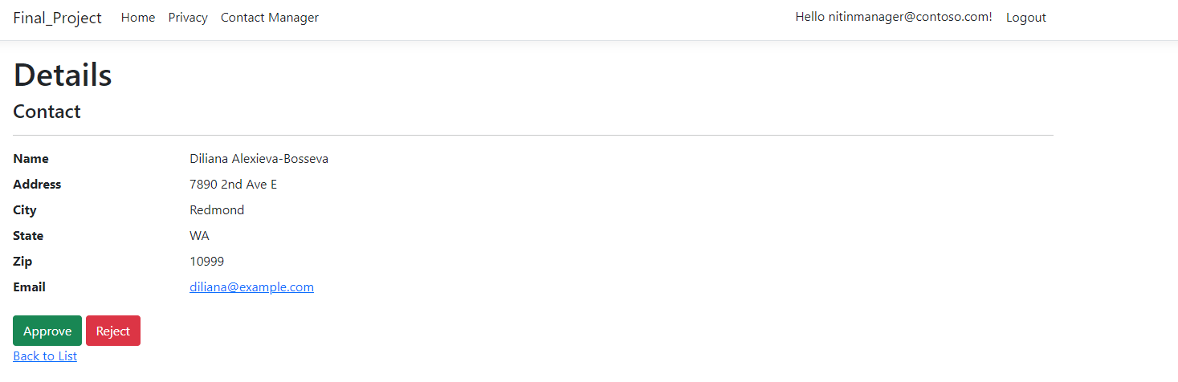
Manager Approve / Reject

Slide 11
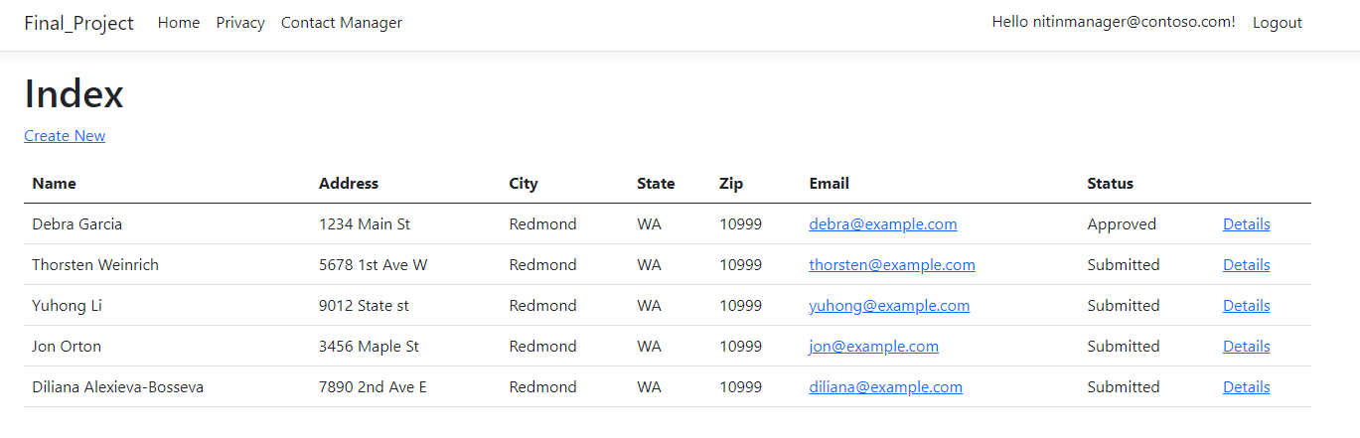
Manager Login

Slide 12
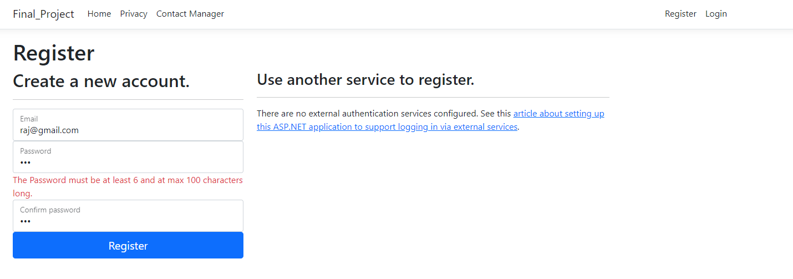
New User Registration Password Validation

Slide 13
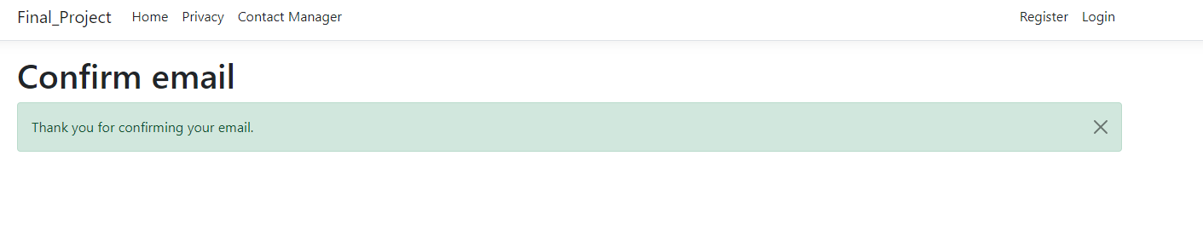
Confirm Email for New User

Slide 14
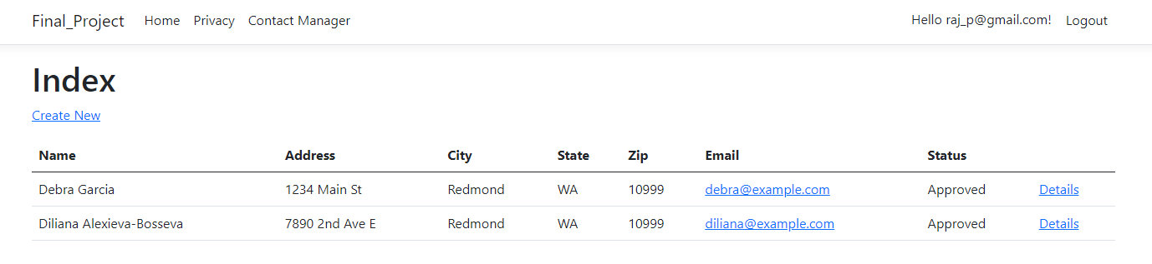
Registered User Access

Slide 15
Go to Actual Demo

Slide 16
Part 2: Security Technologies Recommendations

Slide 17
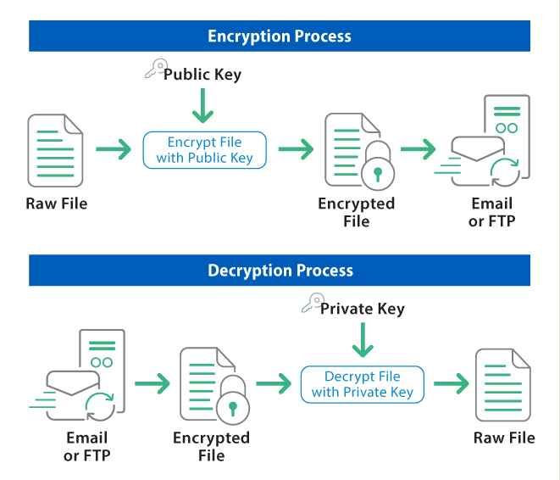
1. How can we transfer personal data securely within their network?
There are a couple of ways to transfer personal data within their network the safest way is by using Encryption along with the protocol.
So, sharing data using FTP protocol and using Encryption algorithms to transfer data within their network.

Slide 18
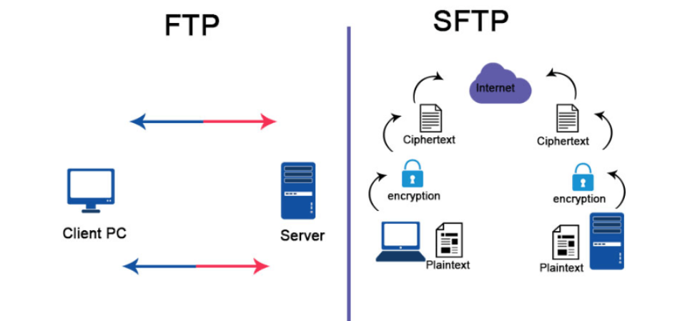
2. What security protocol is best for transferring personal files?
Previously the FTP was wildly preferred to transfer the data over the network then for more security purpose few new protocols were widely used for transferring personal file.
SFTP is a protocol developed by the Internet Engineering Task Force (IETF) and is probably the most widely used file transfer protocol today. SFTP utilizes Secure Shell encryption to encrypt transmitted data
Notes:
SFTP is a protocol developed by the Internet Engineering Task Force (IETF) and is probably the most widely used file transfer protocol today. SFTP utilizes Secure Shell encryption to encrypt transmitted data.
FTPS (File Transfer Protocol over SSL/TLS)
Like SFTP, FTPS creates a secure connection between client and server to transfer files.

Slide 19
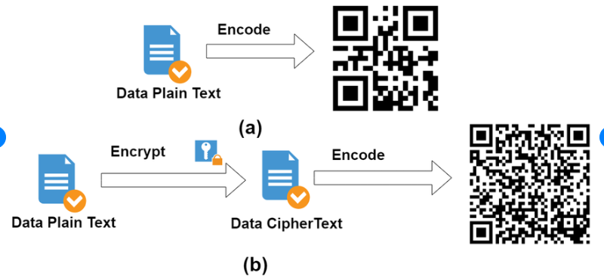
3. Can we encode and encrypt images?
Yes, We can encode and encrypt the images.
Usually, Images are encoded in Base64 formats.
In military the Steganography is a very well-known method for image encode and encryption. It hides the secret message in image.
QR code is another example of it.
Notes:
Steganography is a method of hiding a message in an image, text or even video, but it is not a true encryption process. In a digital image, a second image can be hidden within the first by selectively replacing some of the binary data representing the color and intensity of each pixel with its opposite value. A common steganographic method, called the least significant bit method, modifies the unit values ​​of binary image data to change 1s to 0s and 0s to 1s. To hide another image, only part of the binary image data needs to be changed. Steganography can be used to add digital watermarks to images to protect copyrighted material from theft, but it can also be used to hide stolen data or sensitive information. Steganographic images are easily decipherable unless they are encrypted with other software.

Slide 20
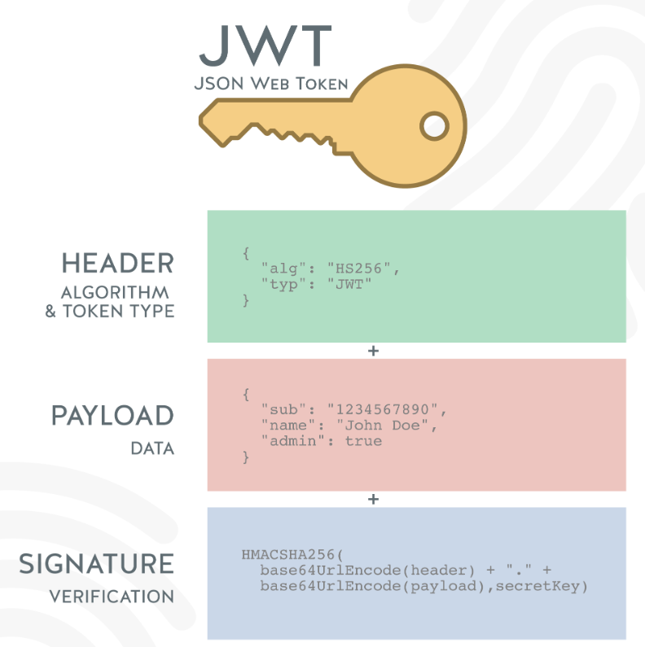
4. Our database cannot be moved from the site, and we need to be able to access it externally using a secure API. Can you explain the architecture of a secure API?
Using JSON Web Tokens (JWTs) in authenticating and authorizing API clients
Notes:
JWT tokens
These tokens contain information about the client,
such as:
Administrator Rights or Expiration.
When a client presents his/her JWT in an API request,
Then API Gateway validates the JWT to ensure that the claims it contains match the access policies that the client has set on the resource it is requesting.

Slide 21
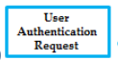


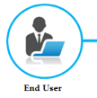
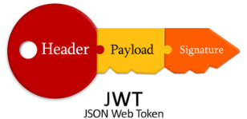

Architecture
DATABASE
Notes:
JWT tokens
These tokens contain information about the client,
such as:
Administrator Rights or Expiration.
When a client presents his/her JWT in an API request,
Then API Gateway validates the JWT to ensure that the claims it contains match the access policies that the client has set on the resource it is requesting.
Ref: https://dzone.com/articles/how-to-secure-apis

Slide 22
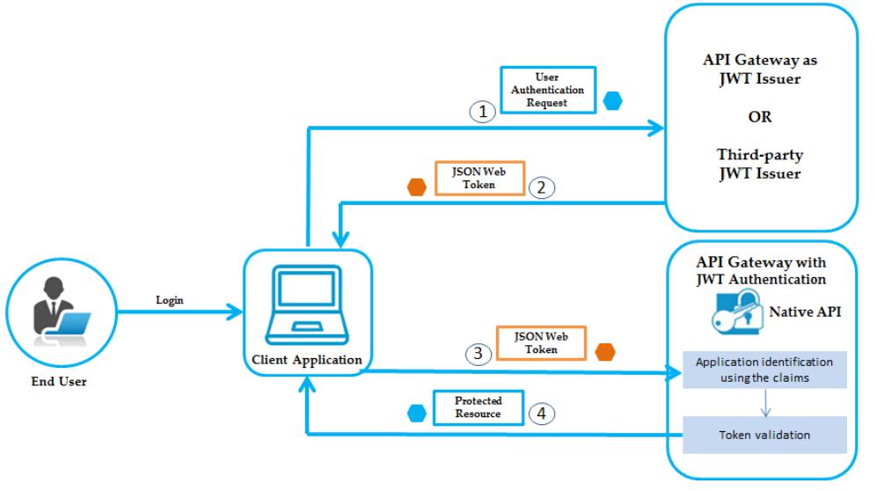
5. Can you recommend a secure framework for coding an API?
Notes:
The JWT authorization workflow is as follows:
1.The end user logs in, the client application sends an authentication request to API Gateway or to any third-party JWT issuer, to obtain a JWT token.
2.If API Gateway is the JWT issuer, then it validates the user or the application. If the user or application credentials are valid, API Gateway generates the JSON token using a private key that was specified in the JWT configuration and sends the generated token to the client.
If the user credentials are invalid, API Gateway returns a specific error response.
3.Client sends the generated JSON token in the HTTP Authorization request header as a Bearer token to access the protected API in API Gateway.
4.API Gateway first identifies the application based on claims from the JWT, then validates the JWT using the public certificate of the issuer (the issuer can be API Gateway or a third-party issuer) and provides access to the protected resources.
If the validation fails, API Gateway returns a specific error response.
authentication alone is not enough to grant access to an API, there should be an authorization step to determine what resources have access to the API. There are various ways to check for proper authorization include content-based access control (CBAC), role-based access control (RBAC) or policy-based access control (PBAC) — these methods ensure business data remains fully protected against unapproved access.

Slide 23

6. What data interchange format should we use while transferring data between locations?
There are many data interchange format available
XML
Text (CSV)
RDF
JSON
Notes:
JSON is the widely used format for sending data between web servers and browsers and mobile applications. Its simple design and flexibility make it easy to read and understand, and in most cases, easy to manipulate in the programming language of your choice

Slide 24
7. How should we store our data in our many locations?
To protect important data from loss or inappropriate disclosure, follow thing should be considered.
Store encrypted data on all devices
Store into more than one copy (Depends on data size and budget of an organization. Cloud is the best option)
Keep the data backup in encrypted form.
Notes:
1. Enable full disk encryption on all devices
On devices where confidential data is stored or transmitted (i.e., most of them), be sure to enable full disk encryption (FDE). Encryption protects the data in case the device falls into the wrong hands. In Windows, the FDE tool is called BitLocker. The macOS equivalent is FileVault. FDE is enabled by default on most iOS and Android phones; don’t disable it unless absolutely necessary.
Store more than one copy
Store your data in several places isolated from each other. For example, you might keep one copy of a file on your computer and another on an external drive or in reliable cloud storage. Again, don’t forget to encrypt the files beforehand (or follow all other advice here).
Encrypt backups
Backups are crucial, but they can also be a source of leaks. That’s why, before creating backups of confidential data, you should place them in a cryptocontainer.

Slide 25

8. What are the ethical concerns related to the transmission of personal data?
Freedom from unauthorized access to private data(privacy rights)
Inappropriate use of data
potential for harm
Client Trust issue
Notes:
Freedom from unauthorized access to private data. Inappropriate use of data. Accuracy and completeness when collecting data about a person or persons (corporations included) by technology. Availability of data content, and the data subject's legal right to
Clients who cannot trust professionals to treat information as confidential may withhold information that is important to assessment and treatment. When professionals disregard the privacy of their clients, the clients are injured in obvious and/or subtle ways. Access; ownership.

Slide 26
Repository Link
Github Link : https://github.com/Nitin-Thakkar/ASP.Net-Authorization_and_authentication

Slide 27


